Slide 1
PRODIGY
Power UP your Grammar
Academic Instructor
Dr. Meirav Taieb-Maimon
By Guy Manzurola
Notes:
Prodigy is a game based learning tool for english grammar

Slide 2
Prodigy is a Game Based E-Learning Tool
What is E-Learning?
Study anytime, at your own pace.
Delivered through digital devices (computer, mobiles etc.)
Cost-effective (no humans involved in teaching, provides automatic feedback)
Accessible

Slide 3
Goal
Keep Players (Students) Coming Back !
Create a playful environment for practicing multiple choice English grammar questions.
Keeping students engaged and motivated throughout the exercises.
First feedback is positive – Players wanted to try it again!

Slide 4
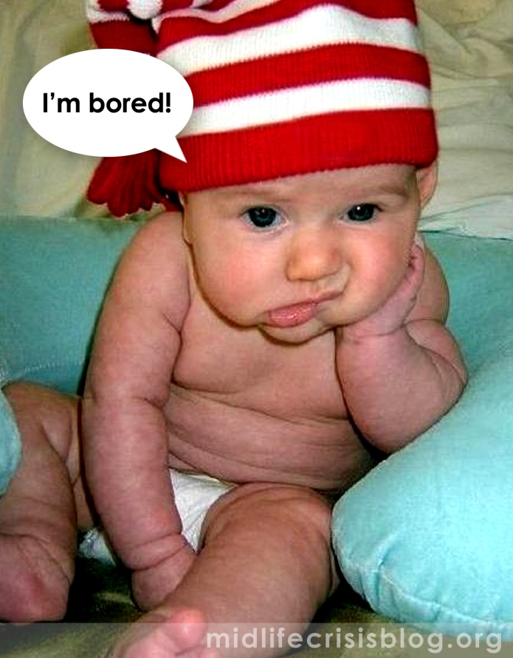
The Problem: Keeping Learners Motivated
It has always been one of the teacher’s primary roles to motivate students through the learning process.
Motives of a student:
Connection with the learnt
material (rare)
Extrinsic rewards
Intrinsic goals
Fear
Pleasing others
(Prensky, 2002)
Notes:
Problem:
Educators are mainly concerned with getting the material across, to instruct.
Motivation relies on:
-connection with the learnt material (rare)
-extrinsic rewards (get score over x, I’ll buy you a Lego set)
-Intrinsic goals (I want to be able to do Y, so I learn more)
-Fear (If I don’t do it, Z will happen)
-Pleasing others (Teacher will like me if I do this)

Slide 5
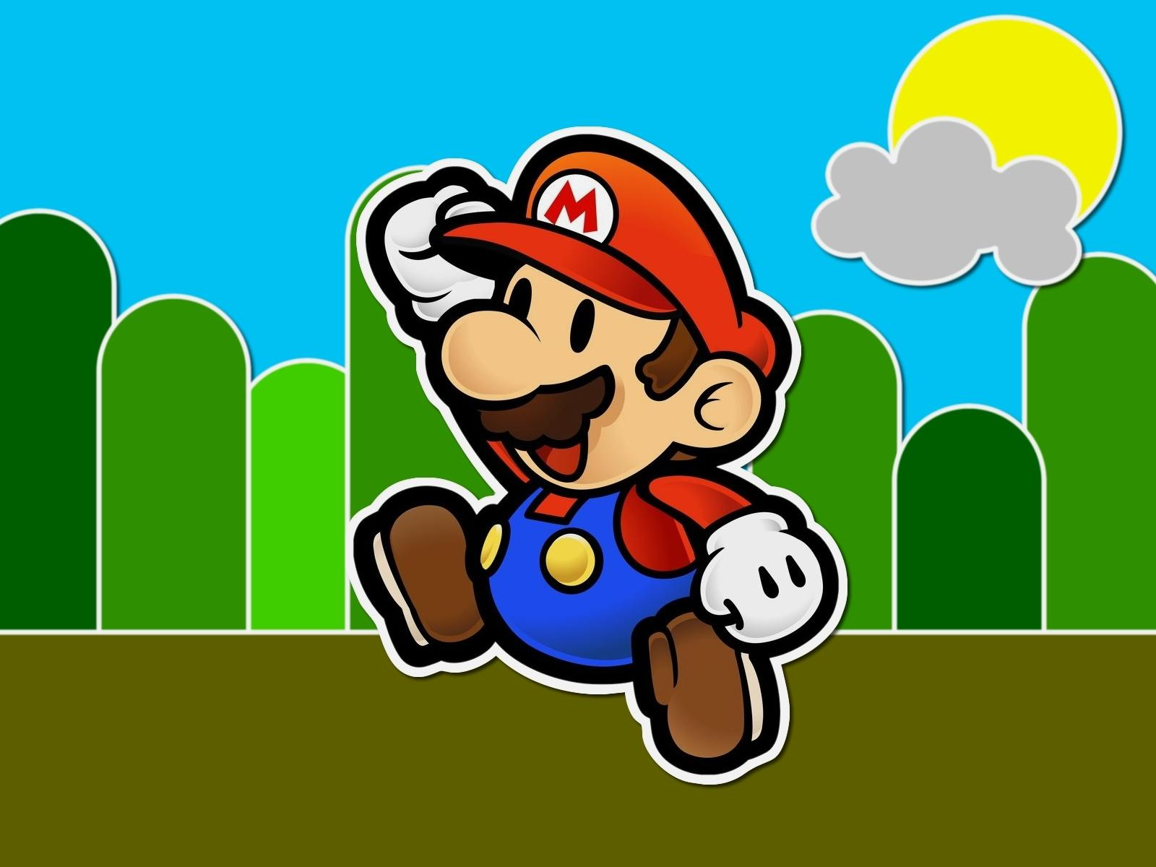
What Makes Things Fun To Learn?
Characteristics of a Good Game (Malone, 1980):
Challenge
Goals (performance feedback)
Uncertain Outcomes (multiple level goals, variable difficulty levels, hidden information, randomness)
Self Esteem (keep it high)
Fantasy
Extrinsic Fantasy
Intrinsic Fantasy
Curiosity
Sensory (sound and graphics)
Cognitive (surprising and constructive feedback)
Notes:
Learning and games:
Implement a learning tool using principles from game design.

Slide 6
Implementing computer game design principles
Score (multiple level goals)
Players play to achieve a top score
Combo (multiple level goals)
Players are rewarded more points when answering correctly consecutively
Health (challenge)
Mistakes decrement limited Health – players try no to die
Time (multiple level goals)
Players play against the clock and are rewarded on faster performance
Sensory Curiosity
Different animations on correct and false moves
Different feedback on correct moves
Hints granted on false answers
Examples: Street Fighter X Tekken, New Super Mario Bros, Devil May Cry 5

Slide 7
Problems Encountered
Weakly defined requirements – Wishful thinking..
Defining Inputs / Outputs
Adding unnecessary complexity
Gold plating – Ego / Difficulty in focusing on one specific aspect.
Lack of Common language with the Instructor.
Too much design and new ideas – hard to focus.
New Technologies – Java Servlets, Tomcat, HTML5, CSS3, Javascript, jQuery.
Managing the construction of a web application without MVC (etc.) web frameworks (JSF, ASP..)

Slide 8
Problems Encountered (cont.)
Separation of concerns:
Client / Server
Screens
Game Engine Entities

Slide 9
Solutions
Had to accept the fact that concepts must be tested before fully implemented. Implementation of the first few concepts eventually led to the current one after testing and playing around with them.
Instructor helped narrow down the scope of the project - helped focus on a well defined set of features.
New technologies – play around and learn.

Slide 10
Solutions (cont.)
Separation of concerns
Client / Server: REST Architecture (HATEOAS)
Client uses links provided in responses to access additional resources – start with a single entry point
Screens: separate functionality to JS modules. Integrate using jQuery ‘load()’ and history API
Game Entities: OO JS – familiar grounds. First used jQuery – built a number of plugins, but eventually reverted back to JS – better performance and more “ego friendly”…

Slide 11
Lessons Learned
Proof of concept is crucial. Start prototype coding as soon as possible (in this situation)
When user experience is the goal – (as is in games) test and test again to get a concrete feeling
Develop and focus on one feature at a time
Code for testing – think about what you want to happen and how you will check it immediately after you code the functionality.

Slide 12
Open Assignments
Writing new levels (exercises) – likely to induce small modifications in design and code.
Implementing hints on mistakes
Final tweaks in game logic
Implementing the welcome and level selection screen
Game Over Screen
Implementing persistent score boards
Integrating screens
Testing
UI refinement – animations, etc..
Refining server side code
Implementing Servlet in a production container (University)
Closed Beta testing (real ESL students)

Slide 13
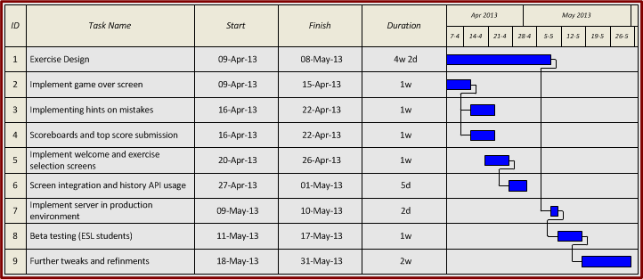
Work Plan

Slide 14
FIN
Good Luck !

Slide 15
Typical Multi-Choice Question
I ___ on a chair and ___ a banana.
Blank
Blank
Choices:
Choices:
seating
am seating
seat
seats
eats
am eating
eat
eating

Slide 16
Architecture
HTML5
(JavaScript, CSS3)
Top Tier
Client
AJAX
JSON
HTTP GET
REST
Tomcat 7
REST Resources
Model Entities
Middle Tier
Server
Hibernate ORM
Hibernate
Tomcat Managed Connection Pooling
MySQL Database
Bottom Tier
Database

